Slide 1
Secure Data Hiding in Images Using Steganography
CAPSTONE PROJECT
Presented By:
Student Name : HARSHITHA M
College Name & Department :
RAJALAKSHMI INSTITUE OF TECHNOLOGY
B.TECH COMPUTER SCIENCE AND BUSINESS SYSTEM

Slide 2
OUTLINE
Problem Statement
Technology used
Wow factor
End users
Result
Conclusion
Git-hub Link
Future scope

Slide 3
Problem Statement
With the rise of digital communication, data security is a major concern. Traditional encryption methods can attract unwanted attention, making them vulnerable to interception. This project leverages steganography to embed secret messages within images, ensuring secure and discreet communication.
ABSTRACT
This project addresses these challenges by implementing a steganographic approach to securely embed secret messages within images. Using Python and OpenCV, the system hides encrypted text inside image pixels in a way that remains imperceptible to the human eye. The embedded message can only be extracted using the appropriate decryption key, ensuring both confidentiality and discretion. This method enhances security by allowing covert communication without raising suspicion, making it a valuable tool for secure data transmission in sensitive environments.

Slide 4
Technology used
Python – Core programming language
OpenCV – For image processing and manipulation
ASCII Encoding – To convert text into pixel values
File Handling – For reading and writing images

Slide 5
Wow factors
Invisible Encryption: This technique ensures that hidden messages remain undetectable to the naked eye. Unlike traditional encryption methods that may attract unwanted attention, steganography seamlessly embeds data within images without altering their visual integrity. This makes it an effective tool for covert communication and secure data transmission.
Password Protection: To enhance security, the embedded message is protected with a password, ensuring that only authorized users can decrypt and retrieve the hidden information. This additional layer of security prevents unauthorized access, making the system more reliable for confidential communication. By integrating encryption with steganography, the approach significantly strengthens data privacy.
Minimal Image Distortion: One of the key advantages of this method is that the image quality remains almost unchanged after embedding the message. The alterations made to the pixel values are subtle and imperceptible, preserving the original appearance of the image while securely storing the hidden data. This ensures that the presence of a secret message does not raise suspicion, making it a highly effective and discreet communication method.

Slide 6
End users
Cybersecurity Professionals: Steganography helps cybersecurity experts securely transmit sensitive data without attracting attention. By embedding encrypted messages within images, they can prevent unauthorized access and reduce the risk of interception.
Journalists & Activists: For those in restrictive environments, steganography enables discreet communication. It allows them to share critical information securely, avoiding surveillance and censorship.
General Users: Everyday users can use steganography to hide personal data, such as passwords or confidential messages, within images. This ensures privacy and protects sensitive information from prying eyes.
.

Slide 7
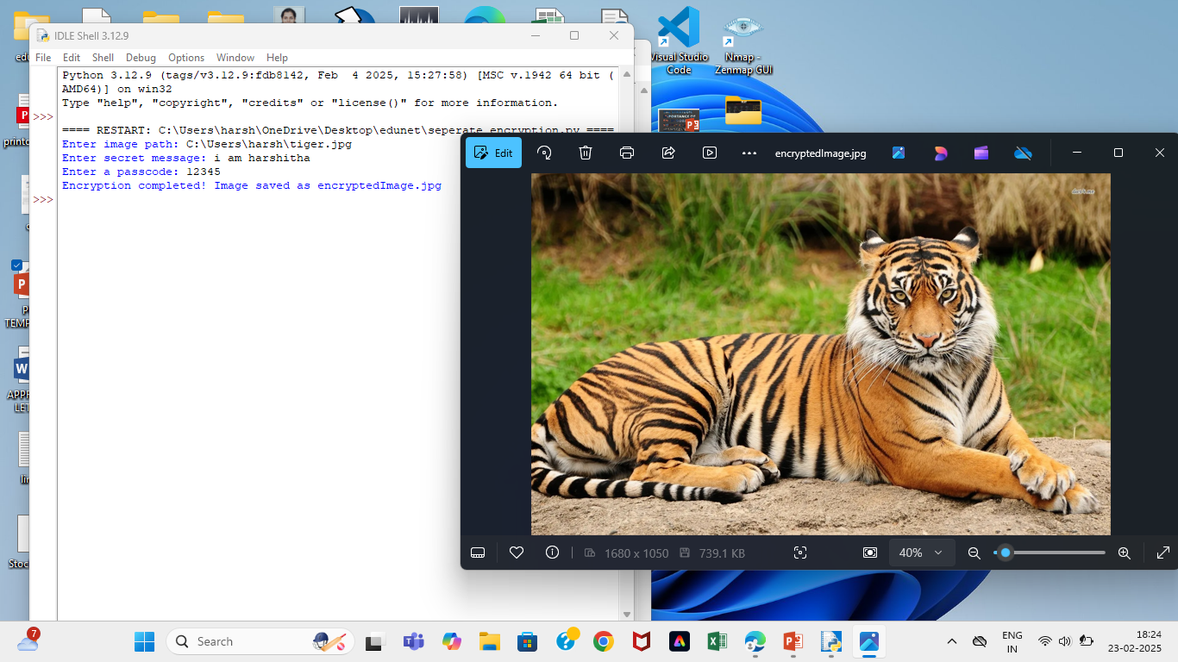
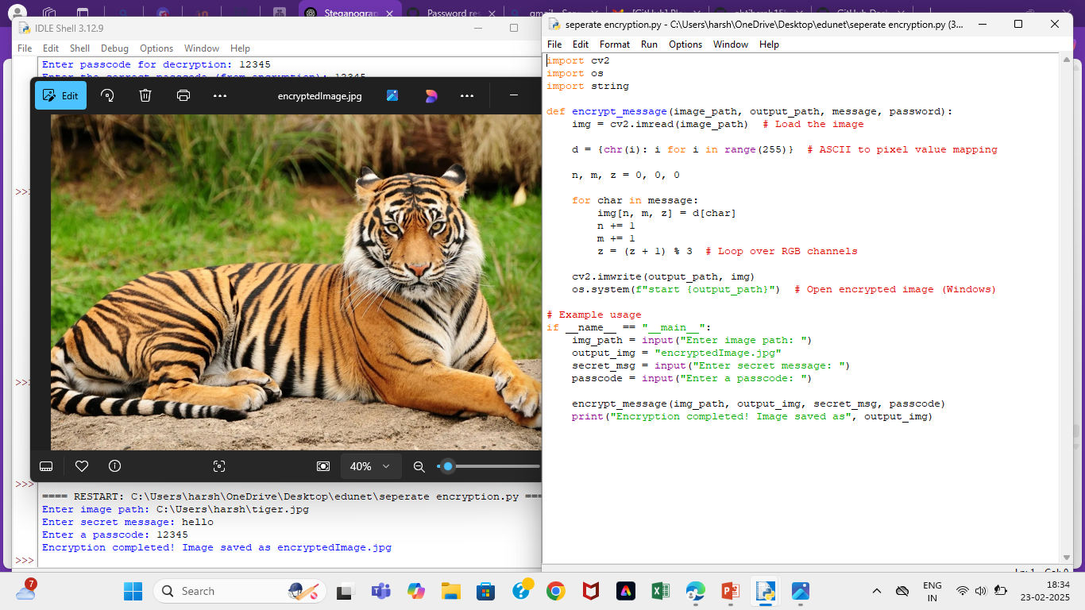
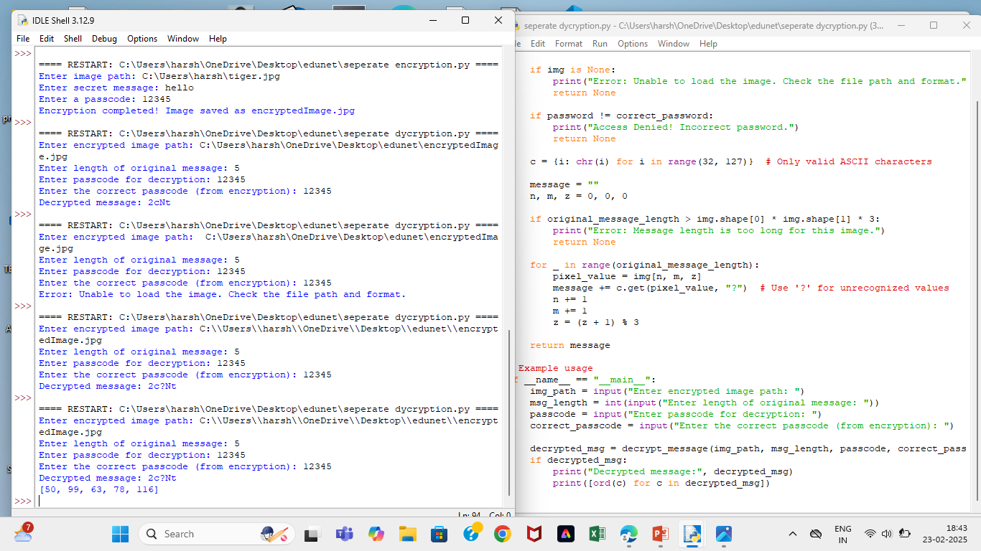
Results
Screenshots of the outcome (min 3)

Slide 8
Conclusion
This project successfully demonstrates the use of steganography for secure and discreet communication by embedding encrypted messages within images. By leveraging Python and OpenCV, the system ensures that sensitive information remains hidden without noticeable changes to the image.
The implementation includes password protection to restrict access, ensuring that only authorized users can decrypt the message. Additionally, the approach maintains minimal image distortion, preserving the original quality of the image.
The output should be the exact output same as the encrypted message

Slide 9
GitHub Link
https://github.com/ahtihsrah15harshitha/stegnography.git

Slide 10
Future scope(optional)
Support for Multiple Image Formats – Extend beyond JPEG to PNG and BMP.
Stronger Encryption – Implement additional encryption layers.
Multi-Level Steganography – Embed messages in different image layers for enhanced security.
GUI Integration – Develop a user-friendly interface for easy use.

Slide 11
THANK YOU

